Slide 1
GLOBAL MOBILITY
April 2022

Slide 2
CorPorate Housing ASG
First 30 days accommodation support
P750 Germany
April 2022

Slide 3
Corporate Housing Assistance P750 - GCP - First 30 days accommodation in Germany
1
General Information
4
Documents for
the authorities
2
Boardinghouse
- What to expect
5
Arrival/Depature
Procedure
3
6
Other Tips &
Covid Information
Booking Process
Create Accommodation Voucher
Apartment
Revoke an Accommodation Voucher
Booking confirmation

Slide 4
General Information
Within Germany People Mobility and Corporate Housing ASG offers the employee on P750 assignment to Germany cost free accommodation in a boarding house up to the first 30 days after arrival.
This accommodation offer is valid for only initial 30 days of your landing in Germany.
If you have not already found a private accommodation and you would like to take advantage of this offer, you will find all the information about the process and how to apply for a boardinghouse in this presentation.
The use of this offer by Accenture is only possible through our external provider Chairos Corporate Housing Services GmbH and must be done through the booking tool myCHS. Detailed information about the booking process and steps can be found starting on slide 7.
Accommodation costs are settled directly with Accenture and are not charged to the employee.
Other accommodation for the first 30 days will not be supported by Accenture.
If your destination cannot be supported through the boardinghouse network, you will get an alternative offer in respective of your travel information provided.
! Due to the situation in Europe and the refugee’s, accommodation possibilities are very limited! Travel time up to 45 minutes to project location can be expected.

Slide 5
General Information
Please note that the search of your boardinghouse will be supported during normal working days and hours (8.00am – 5 pm CET) by Chairos. Please start your booking directly after all your documents and flight are confirmed, but if possible latest 15 working days prior the arrival, so the arrangement can be guaranteed. *1
Boardinghouse Check-In time varies on your arrival time and the provider, mostly 3pm. Chairos will consult you, if an early check-in is necessary.
After the move-in into the arrangement, you can download necessary rental contract & city registration (WGB) through the booking tool myCHS, which enables you to register at the local authorities and to set up a bank account. Please check out slide 15-17.
During your arrangement by Chairos please make sure to search for your subsequent private accommodation, after the first 30 days.
After the first 30 days of your landing, you are no longer eligible to get paid accommodation by Accenture. Please keep in mind to look for a private housing within these 30 days, so you can move individual housing post 30 days of organization accommodation. Please connect in time with your community or look for your own housing independently.
If you would like to extend the rental agreement of the boardinghouse, please contact the boardinghouse provider directly. It must be checked individually, and the rental agreement must be continued and extended in your name and your private costs.
Private extension has to be requested as soon as possible.
Support by Chairos or Accenture is not possible.
*1 - ! Due to the situation in Europe and the refugee’s, accommodation possibilities are very limited! Therefore, also start searching for private accommodation as soon as possible.

Slide 6
Boardinghouse
A Boardinghouse designates a fully furnished apartment.
Basically, a boardinghouse can be defined as a hotel-like lodging establishment with larger apartments and fewer services.
The equipment of a boarding house offers cooking facilities and a refrigerator, as well as towels and bed linen.
Please consider quarantine restrictions and accordingly arrange your food and beverages. Room service is also not available.
Cleaning will be provided once a week.
Washing machines are offered in separate laundry rooms, mostly in the basements.
In general rental services as well as the utilities for the apartment are covered by Accenture in the rental payment.
However additional costs such as e.g., usage of washing machine will have to be covered by you.
International tv-programs are not a standard and cannot be requested. Be aware, that Illegal streaming and download is strictly forbidden. If an illegal usage of a streaming service should come to the attention of the authorities, you are personally held liable for all punishments and costs.
Family accommodation: Boardinghouse apartments are equipped for business travels. Family apartments for 1-2 dependents are not available everywhere. There is no eligibility for a separate dormitory for the dependents. Chairos will try to find an accommodation suitable as possible, but it could also be expected a rental of two sperate apartments or an apartment with fold-out couch - depending on market availability.
! Due to the situation in Europe and the refugee’s, accommodation possibilities are very limited! Travel time up to 45 minutes to project location can be expected.

Slide 7
Booking process
Requirements
Please start your booking directly after all your documents and flight are confirmed, but if possible latest 15 working days prior the arrival, so the arrangement can be guaranteed *1
Following information will be asked during the booking process:
WBS (for accommodation costs)
Project location and accomodation location (if differs from project location)
Number of occupants
Arrival Date & Time
COVID Vaccination status (if by goverment regulation is required)
In following slides, you will get guidance through the process
You will receive the information about your accommodation within 3 – 5 working days (depends on the market availibity).*1
*1- ! Due to the situation in Europe and the refugee’s, accommodation possibilities are very limited! Travel time up to 45 minutes to project location can be expected.

Slide 8
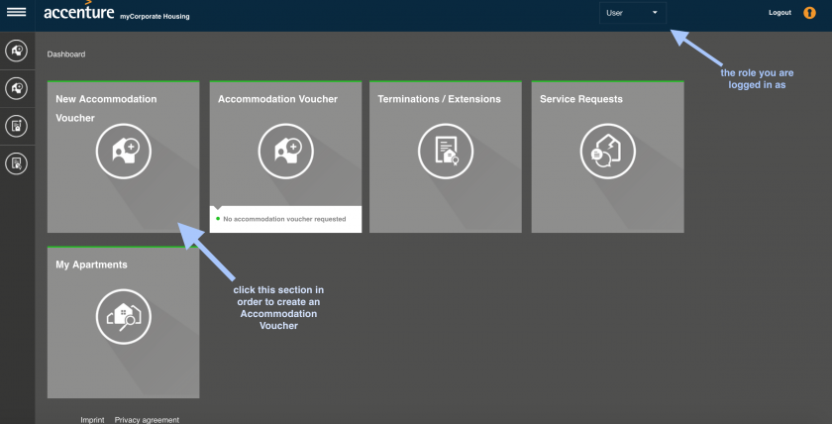
Booking process
Create Accommodation Voucher
Please log into https://mycorporatehousing.chairos-chs.de - booking tool of Chairos – with your Accenture email address and make sure the role you are currently logged in is "User" (see upper right-hand corner).
Now, single onto the section 'New Accommodation Voucher’

Slide 9
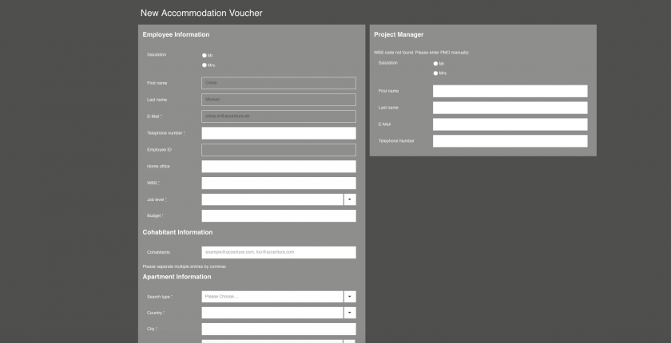
Booking process
Create Accommodation Voucher
Fill out the form with your data.
Search type: "B2BHomer/Chairos search“
Budget: 1000 (amount not relevant, accommodation will be booked on individual market situation)
City: Please enter your accommodation location.
Move-In: Please enter your arrival date
Move-Out: Please enter destination date maximum after 30 night of arrival date (not unlimited!)
If you are asked for the name of a project manager after you entered all data, you have entered the wrong WBS (or with typo/space).
Please make sure you enter a WBS that is exactly eight character long.

Slide 10
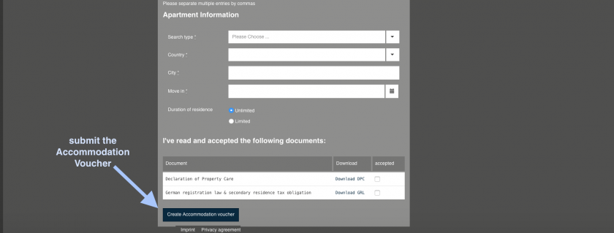
Booking process
Create Accommodation Voucher
Read and accept the attached documents.
Submit the Accommodation Voucher by pressing 'Create Accommodation Voucher’.
Your request for a boardinghouse apartment will be automatically forwarded for approval to the Corporate Housing ASG team by Accenture. Approval can take up to 48h during working days.
After Corporate Housing ASG team has approved the same, the Chairos Sales Team will be happy to take over and start searching for a Boardinghouse and will contact you regarding your arrival details.
! Due to the situation in Europe and the refugee’s, accommodation possibilities are very limited! Travel time up to 45 minutes to project location can be expected.

Slide 11
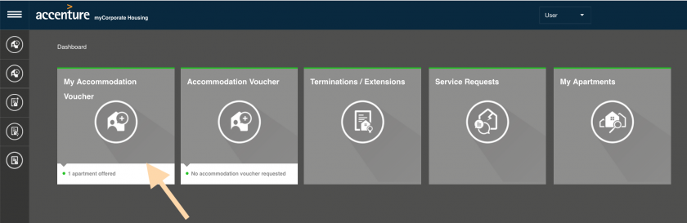
Booking process
Apartment
You will be informed about your apartment in a boardinghouse with a time frame of 3-5 working days, depends on market availibility. *1
You will be informed via email. Whether it will be accessable in the section 'my Accommodation Voucher' on your Dashboard in the myCHS tool or you will receive it directly via email.
If pictures are provided, please notice, these are only examples by the provider. Furniture and section of the room can vary.
*1- ! Due to the situation in Europe and the refugee’s, accommodation possibilities are very limited! Travel time up to 45 minutes to project location can be expected.

Slide 12
Booking process
Apartment
To confirm the rental, please click 'action' on the very right of the proposal.
Choose 'inquire’ to start the final rental process of the apartment as soon as possible, because the apartment can not be blocked or 'reject’ if you do not want our service anymore.
No further offers will be made. Personal wishes regarding the equipment cannot be taken into account.
As soon you choose 'inquire’, Chairos will contact the Landlord and specify whether the apartment is still available and can be rented.
If the apartment is still available, the status of the offer will change to 'available’. You will receive an email about the status change.
Please 'accept' the offer as soon as possible, only then the final signment of the rental agreement can be done by Chairos.
'visitation’ are only possible for project apartments (private landlords), not for boardinghouse apartments! This option is not available for you.
Has the rental agreement been signed you will receive further information regarding your check-in.
You will be able to find the rental contract and apartment data in the section 'my Apartments' on your Dashboard, after the date of your Move In.
*1- ! Due to the situation in Europe and the refugee’s, accommodation possibilities are very limited! Travel time up to 45 minutes to project location can be expected.

Slide 13
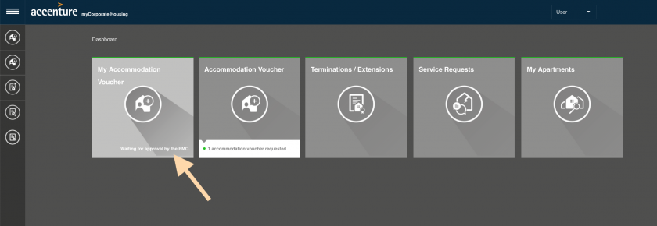
Booking process
Revoke an Accommodation Voucher
If you see that you have submitted a faulty Voucher that needs revision or you travel plan has been changed,
you have to revoke the existing Accommodation Voucher first, before you can create a new one. In order to do so, please go to your Dashboard and go to "My Accommodation Voucher"
and press the button "Revoke Accommodation Voucher" at the very bottom of the page

Slide 14
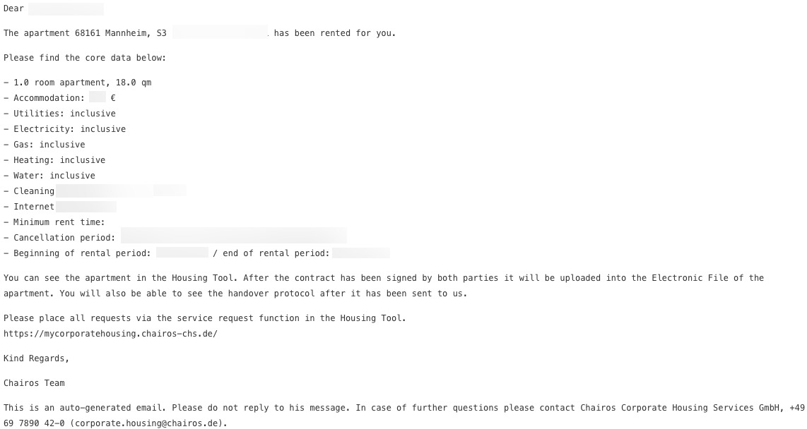
Booking process
Booking Confirmation
As soon as the boardinghouse provider confirmed the booking, Chairos will provide you all information for your Check-In by email and in the booking tool myCHS.
I.e. accommodation address, Check-In hours, Access-key Pick-up location, Contact information, etc.
Picture is only an example
Please note:
You will receive a second “Termination initiated” mail. This is only to inform you to when your booking will conclude.
The corresponding termination will be issued because an end date to your stay has been given.
The end date also marks the date to which your accommodation has been paid for, by Accenture.

Slide 15
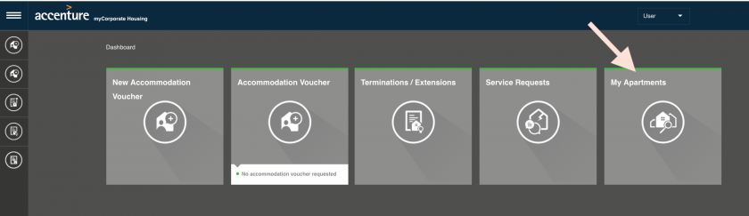
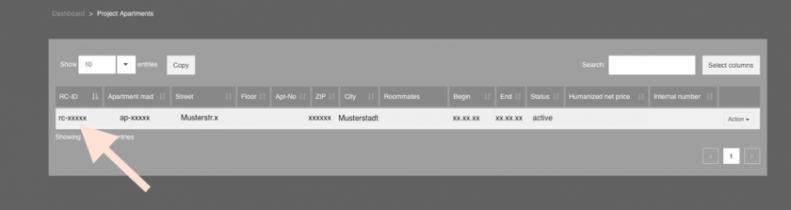
Documents for the authorities
Rental Contract
Will be provided after your Move-In.
Single onto the section 'My Apartments'
and click the rc-ID of the apartment you are currently residing in

Slide 16
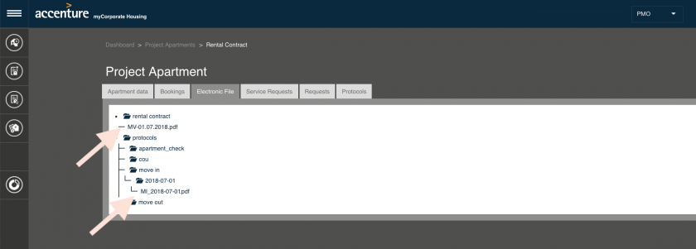
Documents for the authorities
Rental Contract
Go to the third tab "electronic file"
Here, you can download the rental contract “MV- date.” .

Slide 17
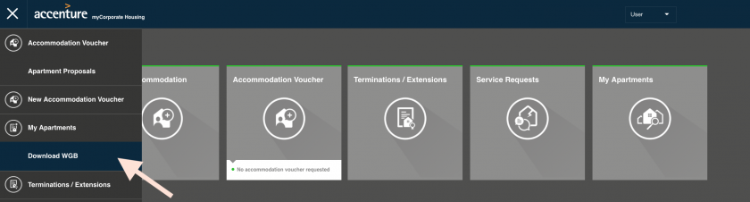
Documents for the authorities
Wohnraumgeberbestätigung (WGB) - City Registration
Will be sent automatically after the rental agreement has been signed to the local assistant for your city registration. You will be in copy of this email.
Also you will be still able later on to download your city registration form after move-in date:
Log into https://mycorporatehousing.chairos-chs.de and make sure the role you are currently logged in as is "User" (see upper right-hand corner).
Hover over the left edge of the window until the section "Download WGB" shows and press it.
The registration will automatically be downloaded and can be handed over for registration.
Should your WGB not be downloadable even though you can see your rental contract in "My Apartments", or some data on the WGB wrong, please do not hesitate to voice the issue in a Service request

Slide 18
Arrival/Depature Procedure
Arrival
Chairos will provide you all information for your Check-In by email and in the booking tool myCHS about the pickup of the key for your accommdation, or you will receive a pin code (depending on the landlord). You will then be able to pick up the key, regardless of your arrival time.
Boardinghouse Check-In time varies on your arrival time and the provider, mostly 3pm. Chairos will consult you, if an early check-in is necessary.
Departure
During your stay you will receive a friendly reminder about your move-out date from the accommodation.
You will be informed, in time, where to leave your keys at the time of your move-out.
The general move-out time will be 10 AM at the day of your departure.
If you would like to extend the rental agreement of the boardinghouse, please contact the boardinghouse provider directly. It must be checked individually, and the rental agreement must be continued and extended in your name and your private costs.
Extension of the boardinghouse agreement/rental contract will not be supported by Accenture or Chairos.

Slide 19
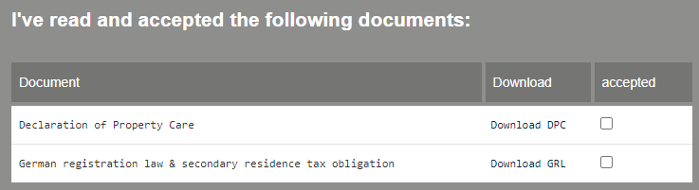
Other TIPS & Covid Information
Tips
Please read the Declaration of Property care (DPC) & German Registration Information- it is an obligation of information ! They are provided in your accommodation voucher
The weekly cleaning service can only clean, as long you have tidied up your accommodation.
Smoking (incl. Shisha/hookah- oriental smoking) is not allowed
Please refrain from cooking with strong smells and aroma. The next tenant will be happy!
You personally will be held liable for all damages, which will occure, also if it has been rented on behalf of Accenture
Pets are not allowed under any circumstance

Slide 20
Other TIPS & Covid Information
COVID Information
Regarding the Covid regulations in Germany, please check out following website to inform about the current status:
https://india.diplo.de/
or German site:
https://www.bundesgesundheitsministerium.de/en/service/gesetze-und-verordnungen/guv-19-lp/coronavirus-einreiseverordnung.html
Please check out at your arrival the status of the regulation of the government also in your region- it can vary.
Useful links- not in any city in place
Food- supermarket: Rewe; tegut, EDEKA
Food delivery service: Lieferando , Wolt ( Frankfurt, Munich, Hannover, Berlin),
Medicine/Pharmacy: DocMorris; medpex
Cosmetics/drugstore: Mueller; DM
General Online Store: Amazon
Contact information:
Chairos C.H.S. GmbH: info@Chairos.de
Accenture Corporate Housing ASG: CorporateHousingASG@accenture.com

